Slide 1


Intrauterine Immunization in During Breeding
Heather L. Wilson*, Pooja Choudhary, Siew Hon Ng, Zahed Khatooni
*Research Scientist and Program Manager for Vaccine Formulation and Delivery Program at VIDO
Adjunct Professor in the Department of Veterinary Microbiology, Western College of Veterinary Medicine and Adjunct Professor in the Vaccinology and Immunotherapeutics Program, School of Public Health, University of Saskatchewan

Slide 2

Pig industry: Protect breeding animals

Slide 3
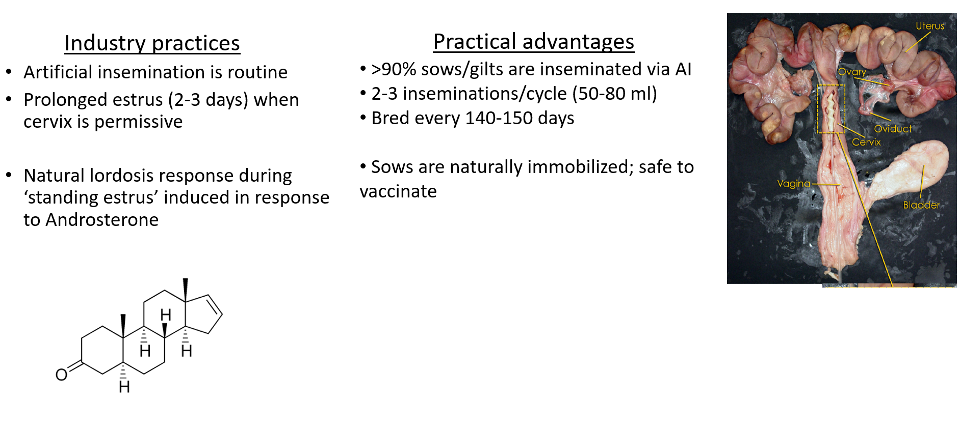
Industry practices make the uterus accessible for vaccination

Slide 4
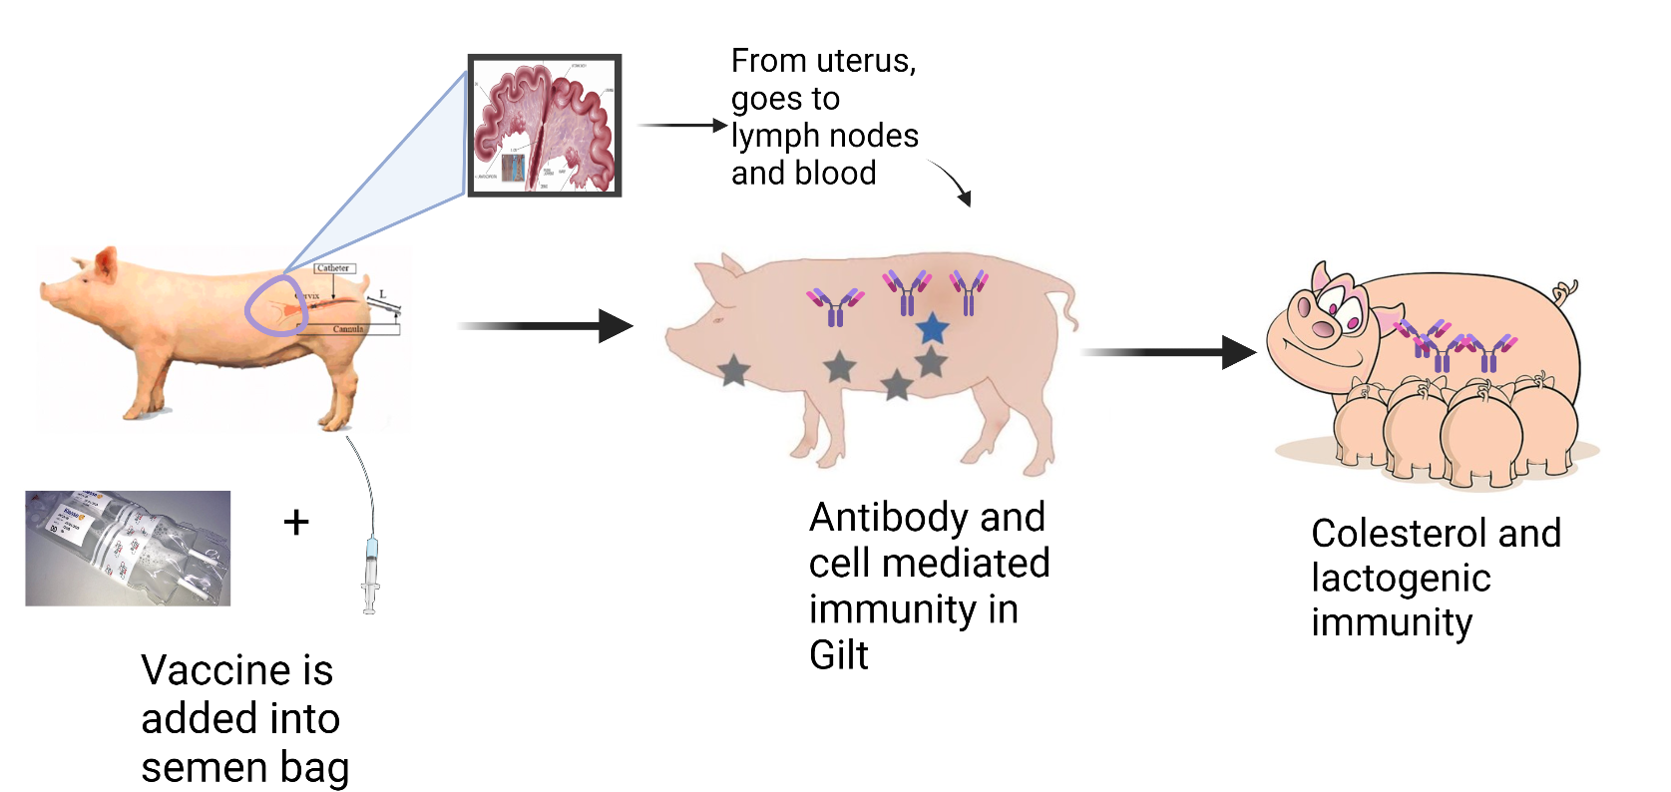
Artificial insemination and vaccination
Protection:
Gilts from reproductive disease
Protects young piglets

Slide 5
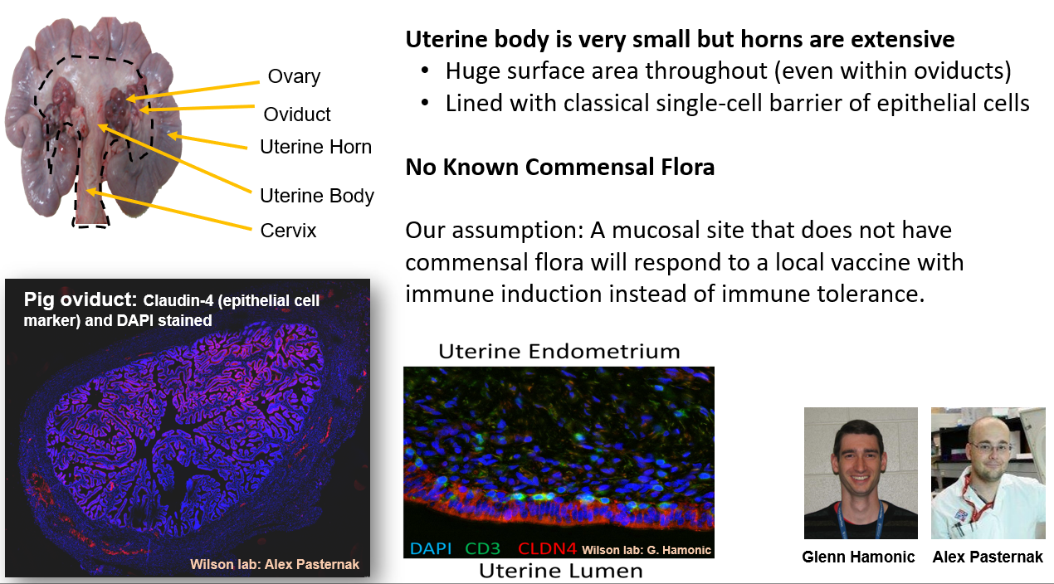
What do we know about the uterine immune system in pig?

Slide 6
To be accepted by the pig industry
Intrauterine vaccines:
  Must not kill sperm
    All commercial vaccines we tested were spermicidal
    Found a combination of adjuvants (Host Defense Peptide/Polyphopshazene/PolyIC) that is not spermicidal with inactivated virus or subunit antigens
  Must not affect fertility
  Must not affect piglet health or growth kinetics
  Must be effective in protecting against disease in the gilt/sow and/or the neonatal piglets
  Must be cost effective and have significant benefits such as reduced person-power, ease of use, improved safety, etc.

Slide 7
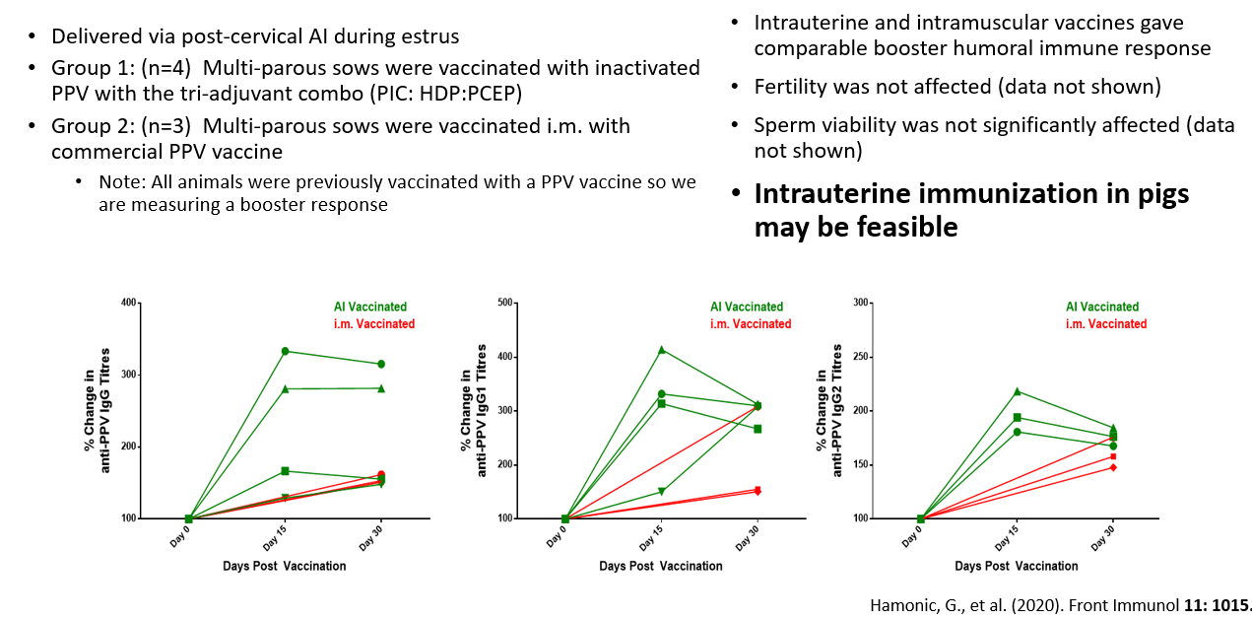
Results from Preliminary Pig Trial- 1 dose

Slide 8
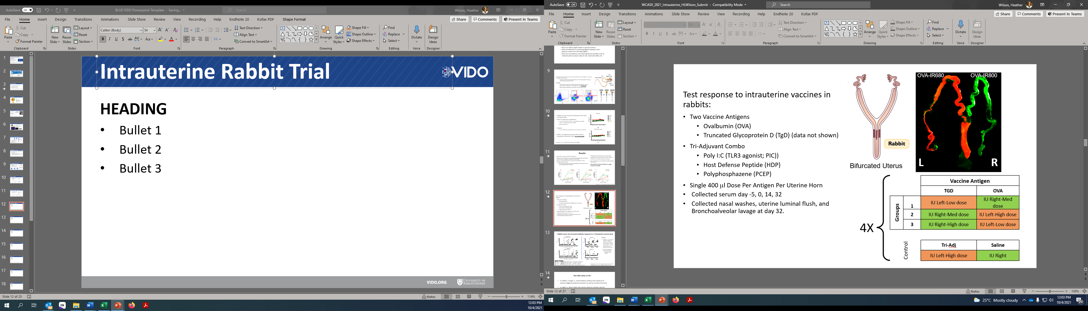
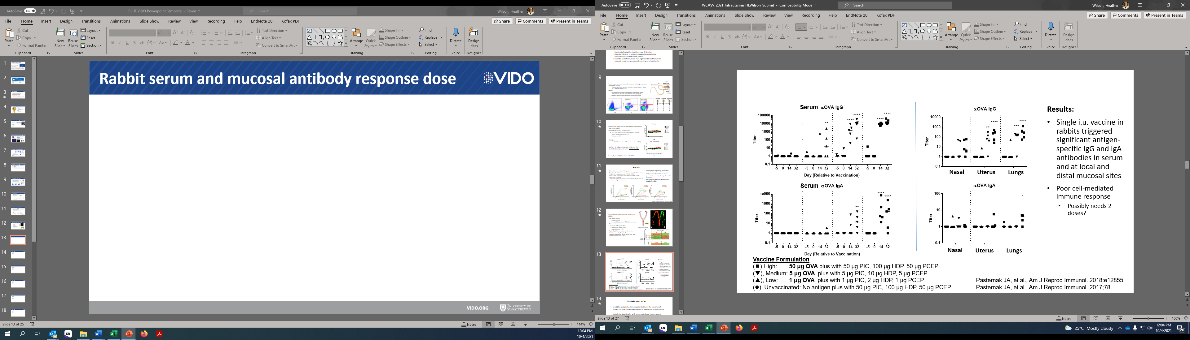
Rabbit serum and mucosal antibody responses
Single i.u. vaccination into rabbits (without semen) triggered significant anti-OVA IgG (and IgA; do not shown) in blood
as well as local and distal mucosal sites. Common mucosal immune system

Slide 9
Key take away so far:
In rabbits, a single i.u. immunization (without the presence of semen) triggered extensive systemic as well as mucosal immunity
Pigs:
Identify vaccine components that are non-spermicidal
A single i.u. dose in gilts with semen acted as a booter vaccine showing that the uterus can be a site for immunization
  But immune response was pretty low. Why?
    Perform multiple immunization trial and assess if the immune response is significantly stronger

Slide 10
Disease Model for i.u. vaccine in pigs
  Porcine Epidemic Diarrhea Virus (PEDV)
  Enveloped virus with prominent spikes; coronavirus
  Affects pigs of all ages but most severe in young pigs
  Water diarrhea and malnutrition
Have an antigen for PEDV= Spike protein (PEDVS) and a very good challenge model developed at VIDO for testing the efficacy of vaccine

Slide 11
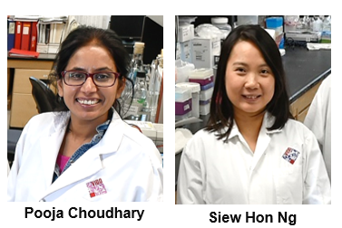




Immunization schedule for i.u. vaccine
Administered 3 doses (one prime and 2 booster doses in one parity)
Vaccine formulated with PEDVS antigen with VIDO Triple adjuvant
n=7 control
n=7 i.u. vaccinated
5 vaccinated gilts
7 control gilts
Gilt Vaccine Response:
Serum antibodies
Colostrum antibodies
Uterine Tissue antibodies
PBMCs (IFNγ response, T cell proliferation)
Primary Vaccine
Booster Vaccine
Booster Vaccine
D156
21 days
21 days
114 days gestation
2nd Estrous
(breeding with dead sperm)
3rd Estrous
(breeding with dead sperm)
4th Estrous
(breeding with LIVE sperm)
Piglet PEDV Challenge, D160
D166
Passive protection:
Weigh piglets
Mortality Curve
Fecal shedding (PCR virus)
Day 0
D135 PBMCsCs
D156 Farrow
Day 21
Day 42
.Choudhary et al., 2021 Oct 8;39(42):6322-6332. doi: 10.1016/j.vaccine.2021.08.080. Epub 2021 Sep 15

Slide 12
Gilt serum/mucosal antibody response to i.u. vaccines
Anti-PEDVS IgG in Serum
Anti-PEDVS IgG in Uterine scraping
i.u. vaccine
Serum Anti-PEDVS IgG
i.u. vaccine
Summary
Significant (but low) serum anti-PEDVS IgG antibody titres after 3 i.u. doses
Significant anti-PEDVS local IgG immune response (but not IgA)
Choudhary et al., 2021 Oct 8;39(42):6322-6332. doi: 10.1016/j.vaccine.2021.08.080. Epub 2021 Sep 15

Slide 13
Passive protection for piglets
  Note: Positive control colostrum from gilts from previous trial that fully protected piglets against PEDV challenge
Summary:
Significant PEDVS-specific IgG in colostrum after 3 i.u. doses
Significant but relatively low anti-PEDV Spike protein neutralizing antibodies in colostrum
.Choudhary et al., 2021 Oct 8;39(42):6322-6332. doi: 10.1016/j.vaccine.2021.08.080. Epub 2021 Sep 15

Slide 14
Piglet Growth Kinetics at Birth and Weaning
PRELIMINARY: Just based on a few litters. Needs to be expanded
Preliminary Summary:
Three i.u. vaccinations does not affect number of live births or still births, weight or piglets' average daily gains.
Choudhary et al., 2021 Oct 8;39(42):6322-6332. doi: 10.1016/j.vaccine.2021.08.080. Epub 2021 Sep 15

Slide 15
Piglet challenge study
n=7 control
n=7 i.u. vaccinated
Gilt Vaccine Response:
Serum antibodies
Colostrum antibodies
Uterine Tissue antibodies
PBMCs ( IFNγ response, T cell proliferation)
5 vaccinated gilts
7 control gilts
Primary Vaccine
Booster Vaccine
Booster Vaccine
D156
21 days
21 days
Piglet PEDV Challenge D160
D166
Passive protection:
Weigh piglets
Mortality Curve
Fecal shedding (PCR virus)

Slide 16
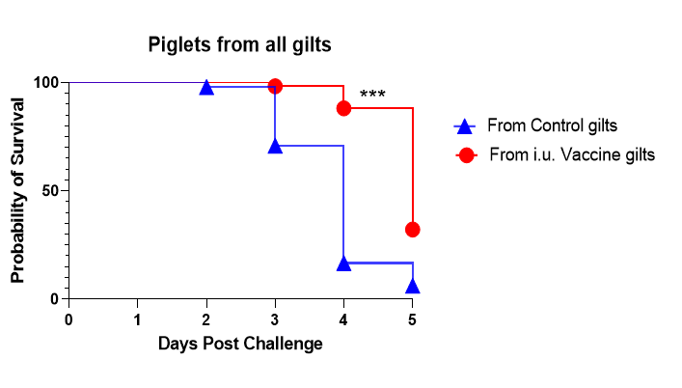
Passive protection against disease
Summary:
Some evidence of protection from neutralizing antibodies
  Substantial improvement is needed

Slide 17

Key Take Away from multi-dose vaccine trials
Fertility is not affected
Antibody immune response (serum and mucosal)
No negative effect on piglet weight or growth kinetics
Evidence of limited passive protection against disease is present

Slide 18
Upcoming Trials
Using techniques to encapsulate the PEDV vaccine such as PLGA nanoparticles:
  Vaccine cannot be spermicidal
    Trial with nanoparticles is underway
    Gilts did not return to estrus which is indicative that the encapsulated vaccines administered with semen did not affect fertility/fertilization
  Many more adjuvants can be tested within nanoparticles
We will increase the number of gilts for more extensive PEDV trial.
Natural repeated immunization at each breeding cycle should be amenable to booster immunizations
Need to establish efficacy in gilts
  may require i.m. vaccine but subsequent i.u. vaccines at next breeding will be the boosters
Need to establish efficacy against PRRSV or other reproductive diseases

Slide 19

Acknowledgments
Previous Lab members
  J. Alex Pasternak
  Glenn Hamonic
  Milan Obradovic
  VIDO Colleagues:
  Nathalie Bérubé,
  Yurij Popowych
VIDO Animal Care
Prairie Swine Center
  Josi Panisson
  Tatjana Ometlic

Slide 20
THANK YOU

Slide 21
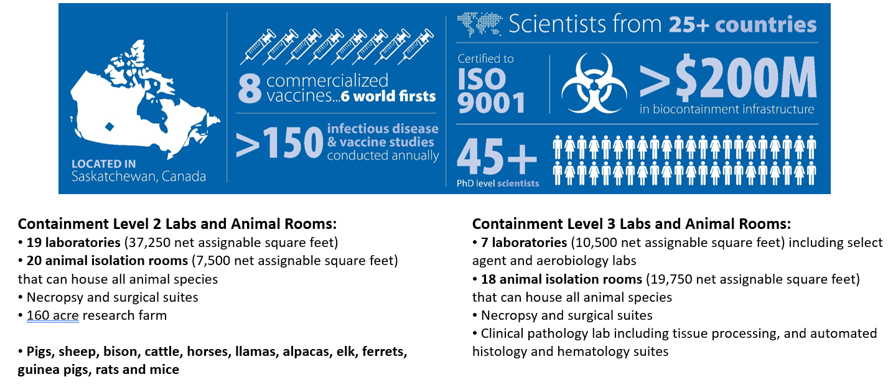
Vaccine & Infectious Disease Centre

Slide 22
Comparison of immune responses between 2 trials (Not official!)
Nanoparticles potentially increase serum and mucosal antibodies but not PEDV Neutralizing antibodies in colostrum.
  Would this be sufficient for PRRSV or PPV vaccine protection against disease?
The i.m. NP vaccine does not appear to augment the i.u. NP vaccine response.
Keep hunting for adjuvants that promote colostral and lactogenic immunity!

Slide 23
Nanoparticle formulation for PEDV i.u. vaccination
Administered 1 i.u. doses with semen followed by i.m. vaccination of Nanoparticle (PEDVS protein plus 2xTLR agonists)
Administered just semen into uterus 1 i.m. doses of Nanoparticle (PEDVS protein plus 2xTLR agonists)
Gilt Vaccine Response:
Serum antibodies
Colostrum antibodies
Uterine Tissue antibodies
PBMCs (IFNγ response, T cell proliferation)
n=4 i.m. control
n=4 i.u./i.m. vaccinated
4 vaccinated gilts
4 control gilts
Primary i.u. Vaccine
i.m. Booster Vaccine
D114
30 days
114 days gestation
2nd Estrous
Piglet PEDV Challenge,
3 days of age
Passive protection:
Weigh piglets
Mortality Curve
Fecal shedding (PCR virus)
Day 0
D100
PBMCs
D114 Farrow
Day 30
.Choudhary et al., 2021 Oct 8;39(42):6322-6332. doi: 10.1016/j.vaccine.2021.08.080. Epub 2021 Sep 15

Slide 24
Gilt cell-mediated immune responses in blood cells
Bioinformatic analysis indicates that PEDV has poor T cell epitopes
Antigen redesign is underway
Summary
No PEDVS-specific IFNγ response after 3 i.u. doses
Likely due to poor T cell epitopes in PEDVS antigen
Repeat trial with PEDVS with optimized T cell epitope
Choudhary et al., 2021 Oct 8;39(42):6322-6332. doi: 10.1016/j.vaccine.2021.08.080. Epub 2021 Sep 15

Slide 25
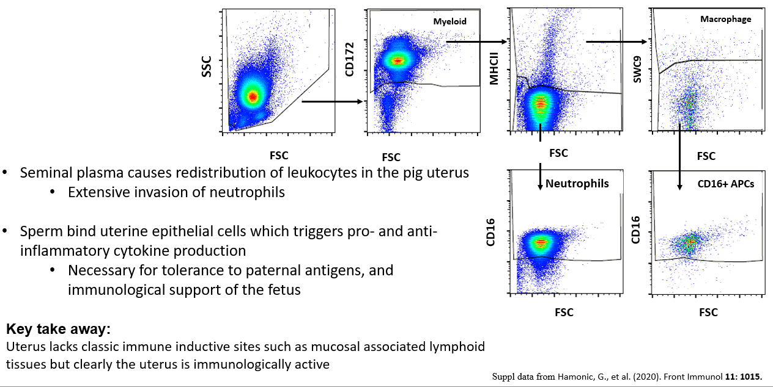
Immunotyping of cells collected from uterine flush post-breeding
What immune cells are present in the uterus after breeding??

Slide 26
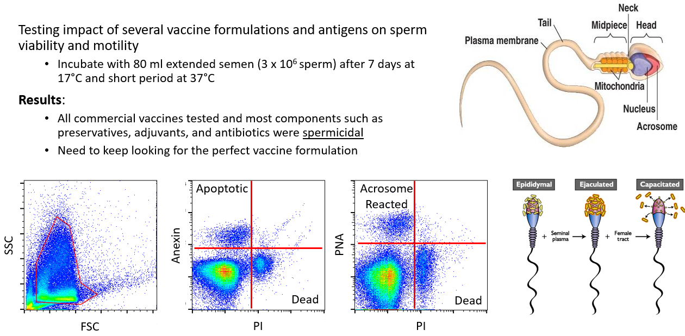
In vitro studies with sperm

Slide 27
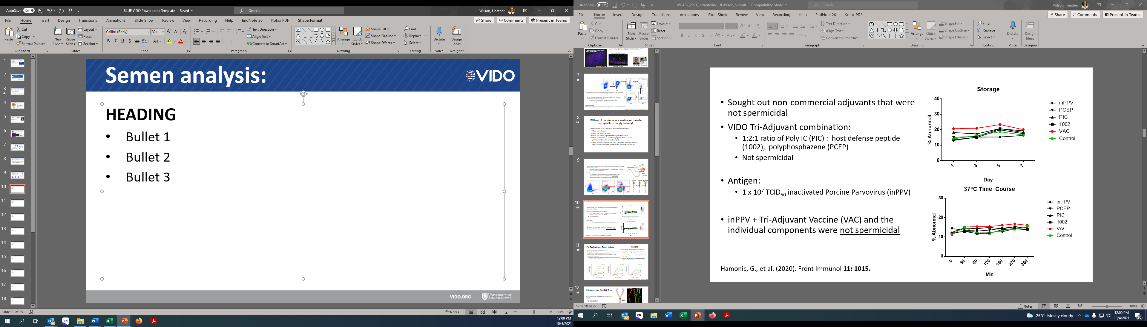
Semen analysis:
Also tested recombinant subunit proteins
Subunit proteins + Triple Adjvuant are not spermicidal

