Slide 1
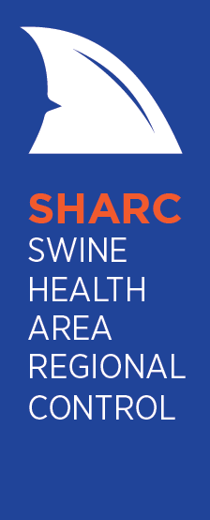
SHARC – Swine Health Area Regional Control
Jessica Fox, Swine Health Ontario Manager

Slide 2
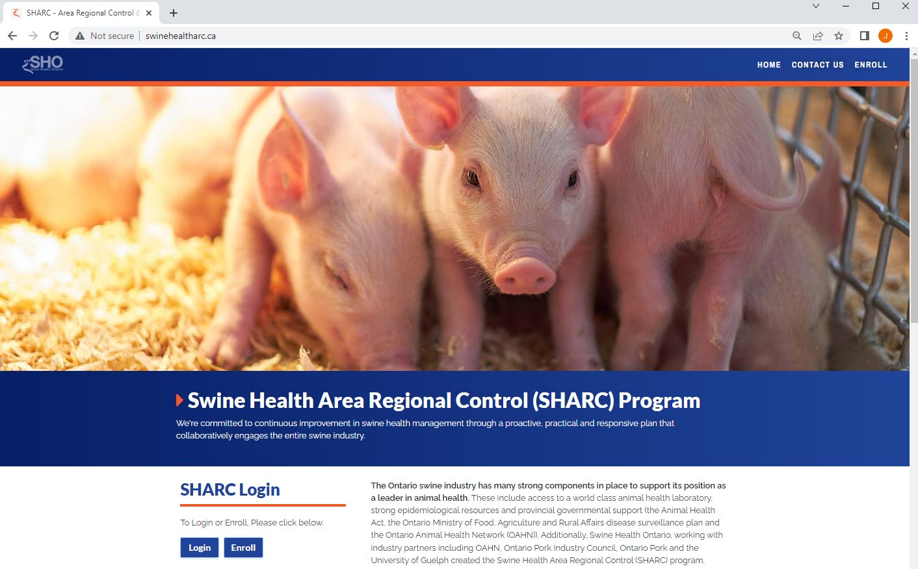
SHARC Program
Voluntary swine disease information sharing system
Developed through extensive consultation with producers and veterinarians
Tracks and maps status of barns for PRRS, PEDv and PDCoV
Operated by SHO in partnership with OPIC and Ontario Pork

Slide 3
SHARC Program
SHARC is a risk management tool
Producers can use the information to make decisions related to hog movements/placements, manure spreading and barn building
No day-to-day management by producers is required

Slide 4
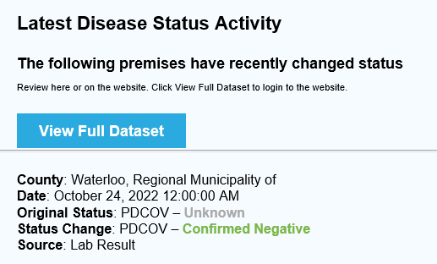
Features
Lab results updated daily from the Animal Health Lab
  Disease status changes my also be requested by the vet of record
Email notices of disease status changes are automated
  Status changes must be approved by a vet; all vets are in the system
  Notices only show the region and the change, NOT the name or address of the farm
  Notification types and frequency can be changed by the user

Slide 5
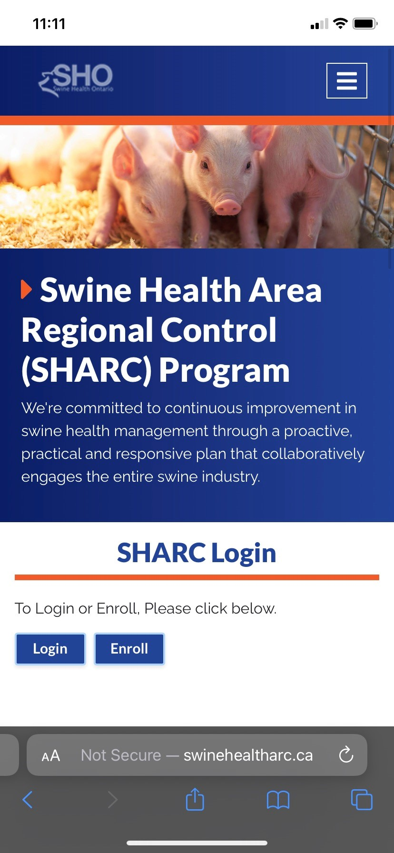
Features
Mass email function enables fast communication to all enrolled producers
Testing history is accessible, genotyping captured when provided
Automatic enrollment of sites as they are added/removed from a producer
  Keep your info updated with Ontario Pork
Mobile compatible

Slide 6

Features
AgManifest data integration – when movements are recorded in AgManifest, ARC&E can move positive disease status automatically
Radius mapping – visualize your neighbourhood
  Now able to see location of all sites registered with Ontario Pork; sites that are not enrolled will not share any identifying information
Producer focus groups continue to provide input

Slide 7
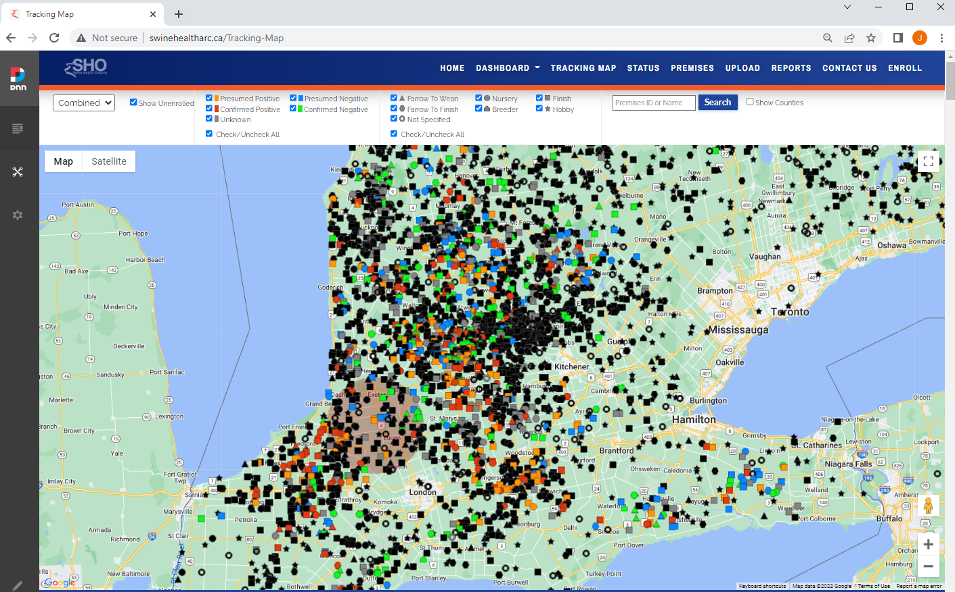
SHARC Mapping Capabilities
Notes:
The admin level of the ARC&E program has the capability to map all premises in Ontario, including hobby farms, which is very valuable in FAD incidents. This allows us to quickly generate a list of farms to contact within the designated radius of control and coordinate responses with the CFIA.

Slide 8
Potential Future Applications
Coordinated regional control efforts/vaccination trials
Integration of permitting based on zones during a foreign animal disease event
Inclusion of any other disease of interest (e.g., African swine fever)

Slide 9
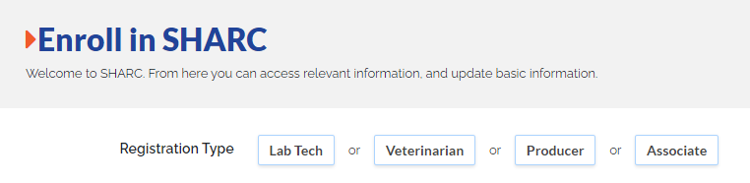
SHARC Enrollment
Currently ~48% of hogs in Ontario are enrolled; the greater the enrollment, the more robust the system for producers to help producers
Producers who have not yet created a login, please visit swinehealtharc.ca/Enroll today!
  If you had a login for ARC&E, your same login information can be used in SHARC

Slide 10
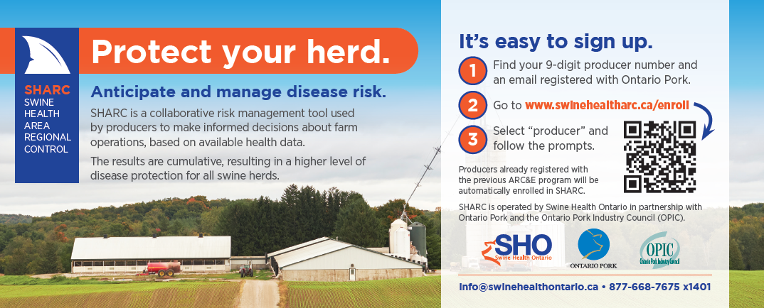
SHARC Enrollment
If you would like a demonstration of the system for yourself or your organization, please contact info@swinehealthontario.ca
Info cards are available today

Slide 11
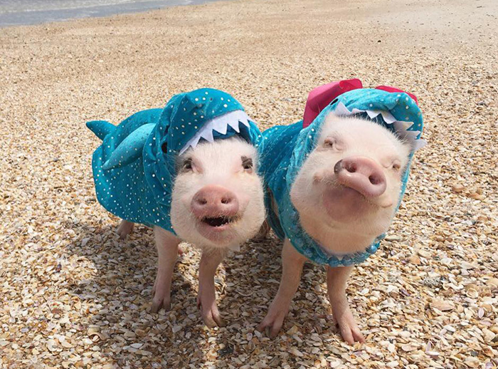
Thank You!

